Slide 1
Start
“Can I touch your hand?”
TTC = 1
Movie (see below)
14
WIN (consensual sex)
3
4
Restaurant
Eat the food and don’t say anything.
Exiting the restaurant
“Why don’t we go back to your place?
If TTC = 1
1
Main menu
Try to steal a kiss
Nightclub (see below)
“Do you wanna have sex?”
TTC = 0
“I made dinner reservations”
If TTC = 0
“I’m not leaving until we do it”
12
“You kinda owe me after all I did…”
15
“Wanna eat something?”
She said no!
FAIL (coercion)
“Do you wanna make out?”
TTC = 1
2
“Wanna watch a movie?”
5
Keep watching the movie
6
11
TTC = 0
You and her/him in the car
Movie
Exiting the theater
“Why don’t we go back to your place?
Apartment. She starts kissing you.
Try to unbutton her blouse
Just go home
Initial tendency to consent (TTC): zero
Move a hand up her leg
Just go home
16
TTC = 0
“Let’s go to the club”
Bummer… (no sex)
“Let’s go to the club”
“Is it OK if we dance really close?”
TTC = 1
“Wanna watch a movie?”
Movie (see above)
8
Just dance together
10
“Let’s hit the floor!”
Dance floor
Exiting the nightclub
“Why don’t we go back to your place?
Slide a hand down her waist
TTC = 0
7
Take her to dance
Offer a drink
Offer a drink
“Wanna eat something?”
Restaurant (see above)
Just go home
Nightclub
Leave the club
“Let’s have a drink first”
9
13
Ask her if she wants to have sex
17
Bar
Get her drunk
Carry her into her apartment
FAIL (can’t consent)
Just start undressing her
Have one drink

Slide 2

The Dating Adventure
Will you get lucky tonight?
Play the game

Slide 3
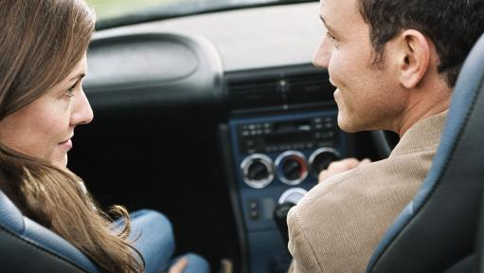
Tonight is the night, you can feel it. You stop at her driveway right when she is leaving the house. She looks stunning, in a short, black dress.
She enters the car, smiles and says “Hey, you! Where are we going tonight?”.
“I made dinner reservations”
“How about we watch a movie?”
“Let’s go to a nightclub”

Slide 4

This was so not cool.
A relationship without consent is a bad relationship. You can’t assume or imply the other person wants to do something: it is fundamental to ask first.
Also, you cannot force someone into saying yes by using coercion, threats, intimidation – physical or verbal – or emotional abuse, like name-calling or humiliation. This is serious business: in Canada, and many other countries, you can be charged with sexual assault or even rape.
Try again

Slide 5

Awesome sauce!
Boy, did we get lucky tonight!
And the best part? You made sure you got consent from your date. This is how you build a healthy relationship: making sure the other party is comfortable and doing only what she wants to do.
But remember: silence isn’t consent. And the other person cannot consent if he/she is drunk or high. So, get that yes before you smash!
Restart game

